Slide 1
Windy Ridge K-8
FIVE STAR
Florida Department of Education
Highest Community Involvement Award
School Award
2017-2018 School Year
Notes:
Add a picture of your school

Slide 2
FIVE STAR
School
Salutes
Windy Ridge K-8
Notes:
Recommended, not required
Showcase School Board Members (all) or Your school’s School Board Member, as well as your area superintendent)
This can be completed in one or two slides.

Slide 3
Principal’s Message
Dear Parents/Guardians and Business Partners:
I want the children of Windy Ridge to enjoy coming to school each and every day. I want the school environment to be a pleasant one, filled with rich experiences, challenging projects, loads of achievements and lasting friendships.
In order to accomplish this task, I feel it is particularly important to develop and maintain involvement with both parents and our community. Parents will be the first to know whether their child is enjoying school, whether their child needs special attention in a specific subject or whether their child’s relationship with a friend is affecting his/her academic development. Our commitment to the children is genuine and the teachers’ interaction with parents is essential to each child’s education – both academically and behaviorally. Local businesses can help to enrich the learning environment Windy Ridge provides by being involved in our school. They can choose to enrich learning by sharing their time and expertise on a topic students are studying or donating supplies/money to school activities.
It is important to build a strong relationship with one another for several reasons. Some of the most important are:
•To motivate children
•To build self-esteem
•To reach common goals together
•To work through difficulties that may arise
•To see that each child enjoys the mental, physical and social activities at school
•To see that each child reaches personal fulfillment
•To nurture and support each child
•To see that each child learns and becomes responsible
Thank you for your involvement at Windy Ridge. I look forward to getting to know you. If you have any questions throughout the year, please contact me.
Sincerely,
Tracy Webley
Principal
Notes:
Recommended, not required
The Five Star School portfolio should be used as a marketing tool for your school; share the wonderful things that are happening daily on your campus.
Principal message should set the tone by introducing the portfolio and encouraging community involvement.
Picture of principal is recommended

Slide 4
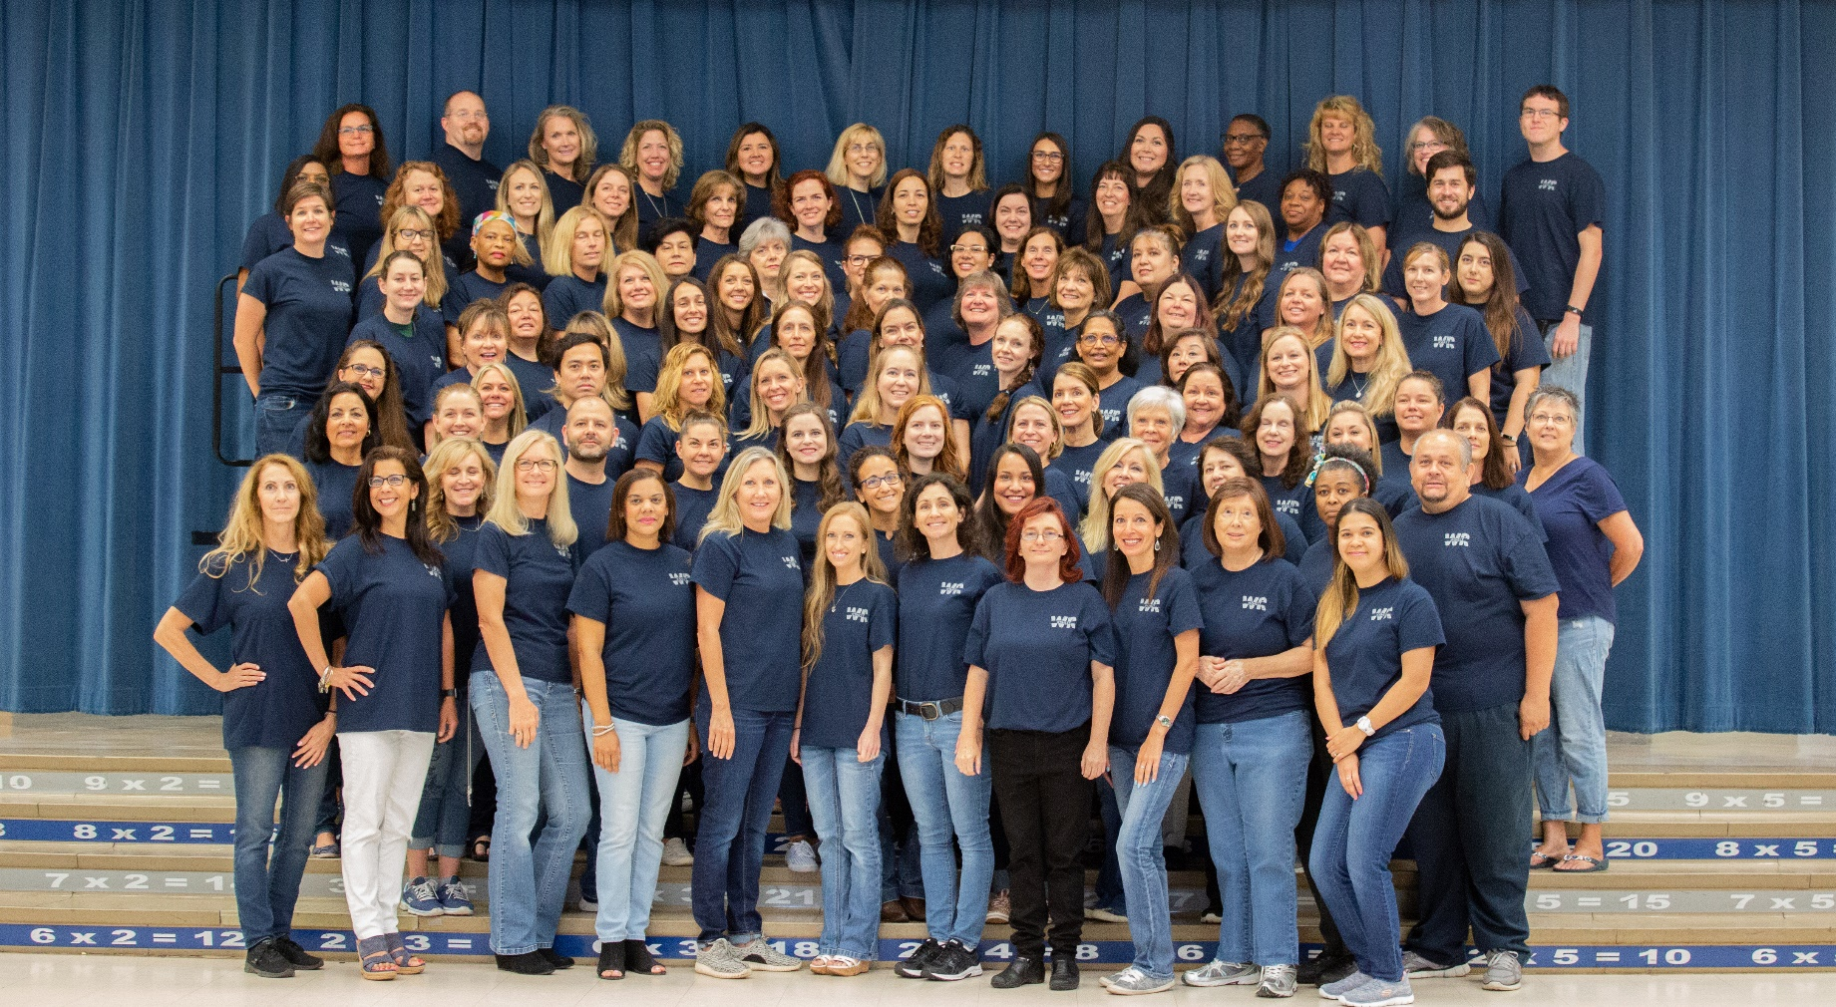
Faculty & Staff
Notes:
Recommended, not required
Introduce the staff to the community – Entire group faculty photo or grade level photos…

Slide 5
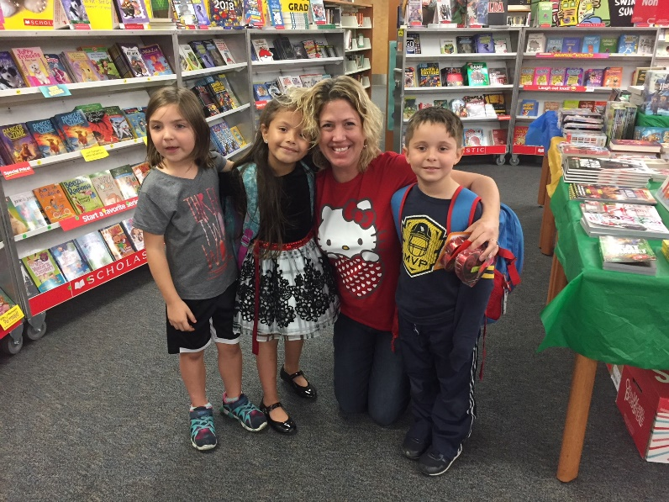
Teacher of the Year
Mrs. Dee
Mrs. Cari Dee teaches 35 weekly classes that rotate through the media center. She runs the incentive program for Sunshine State Young Readers Award book list for both elementary and middle school. She runs the incentive program for the Accelerated Readers program. She created the school wide yearbook. She runs the live morning announcements by teaching 16 middle school students how to run all of the tech equipment. She is the captain of both the 5th grade and the middle school battle of the books teams. She hosts the Modern Woodmen Oration competition for both the fifth grade and middle school competition. Cari is a Future Problem Solvers coach. She is also one of the four Digital Curriculum Teacher leads for our school. AND she has two fantastic book fairs a year as well!
Notes:
Recommended, not required
Great opportunity to recognize your Teacher of the Year – Include a brief synopsis about the Teacher of the Year and a photo.

Slide 6
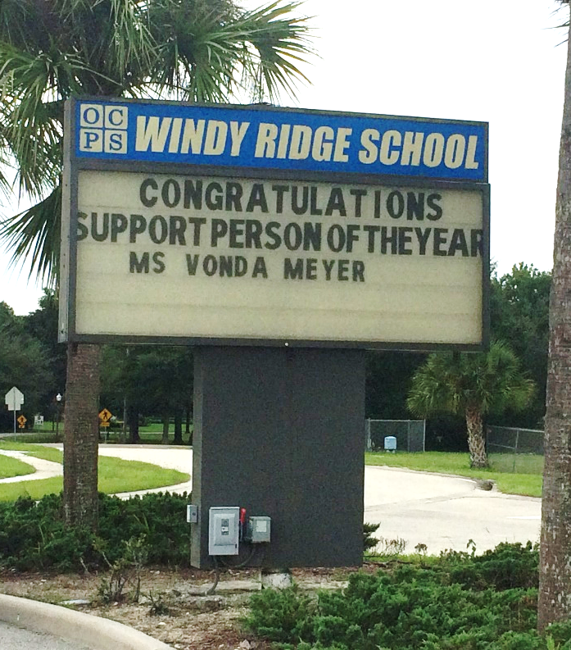
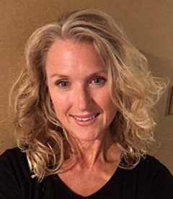
Support Person of the Year
Ms. Meyer
Ms. Meyer has worked as the secretary at Windy Ridge since the 2014 – 2015 school year. The faculty and staff describe Ms. Meyer as a dedicated staff member who is committed to supporting the Windy Ridge community. Her humor and flexibility is a testimony to how much she enjoys working with others. She is described as diligent and conscientious, a true team player.
Notes:
Recommended, not required
Great opportunity to recognize your Support Person of the Year – Include a brief synopsis of Teacher of the Year and photo.

Slide 7
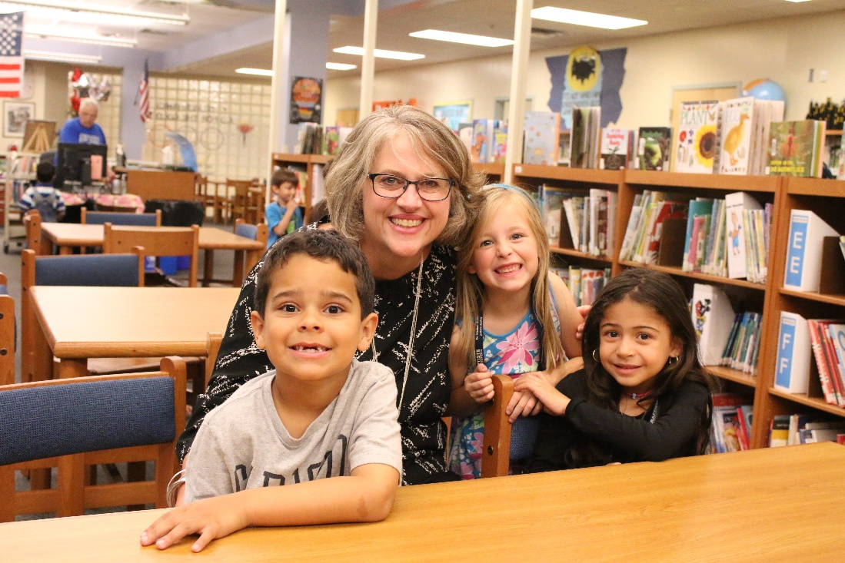
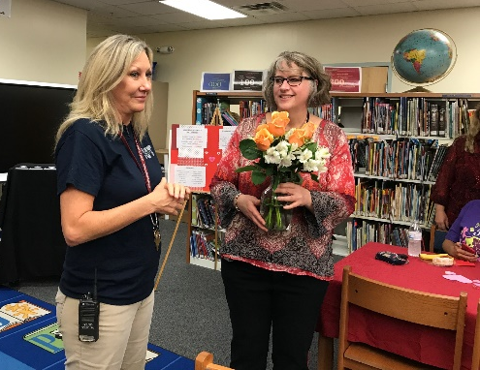
OCPS Counselor of the Year
Ms. Van Sickle
Ms. Van Sickle is honest, dependable, and incredibly hard-working. Beyond that, she is an impressive listener who is always fair to all parties. Her knowledge of what the whole child needs to flourish and her attention to every detail of EACH of our student’s backgrounds is impeccable. Because of Ms. Van Sickle’s determination and devotion, our students learn in an atmosphere of respect and inclusion. Her love for and dedication to each child, along with her ability to take on challenges while balancing a diverse workload make her an outstanding counselor!
Notes:
Recommended, not required
Great opportunity to recognize your Support Person of the Year – Include a brief synopsis of Teacher of the Year and photo.

Slide 8
School Demographics
Windy Ridge’s most current demographic information is White (34.5%), Hispanic (38%), Black (14.6%), Asian/Pacific Islander (11.9%), and Multiracial (.9%). English Language Learners make up 34.1% of our student population. Students who qualify for free or reduced meal program make up 54.5% of our students.
The unique features for Windy Ridge are a low mobility rate, the opportunity to serve the students in our 6-8 Academy, and our self-contained exceptional student education cluster. The Exceptional Education program represents 19.8% of the student population; including 10.3% in the gifted program.
Notes:
Recommended, not required
Described your school to the community. What’s unique about your school?

Slide 9
Community Involvement Opportunities
Within the Five Star School portfolio
look for opportunities you a can participate in, such as:
Partners in Education
Family Involvement
School Volunteers
Student Community Service
School Advisory Council (SAC)
Notes:
Introduce the reader to the different community involvement opportunities/programs happening on your campus.

Slide 10
The Partners in Education program links businesses and organizations with schools to share resources, both in people and materials. Each flourishes from the support and prosperity of the other.
Notes:
OCPS’ official community/business/agency program is called the Partners in Education.

Slide 11
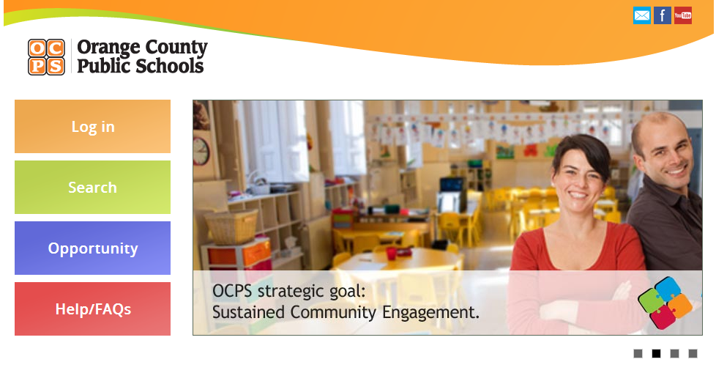
be a Partner in Education
Register to
Partnerships are built on mutually beneficial activities with school needs and business resources as the focus.
Partnering is Easy!
Register online: volunteer.ocps.net
Click on “Get Involved”
Search for an Opportunity
Look for our school name and sign-up for “Become a Partner in Education” opportunity.
Notes:
Required
Each note section will include the criteria from the Five Star Application.
In lieu of using criteria as a heading – use the summarizes the criteria heading included in the slide
Criteria - Each community/business/agency signs an annual, jointly developed plan of partnership activities.
Showcase an example of one of your school’s Partner in Education profile’s from the new Partners in Education Management system. Must refelect this school year’s partnership.

Slide 12
Our Partners in Education
CMB Martial Arts Academy Orlando
Notes:
Business maintains an ongoing, active relationship with school.
A list of your current partners. This is a great area to place their company’s logos.
You may also include your PIE roster from the PIE Management system

Slide 13
School Improvement Plan Receives Business partner Input
Partners in Education
Windy Ridge receives input from a community business member
Kurt Meusel
Gaylord Palms Resort & Convention Center
Notes:
Business is involved in development and implementation of School Improvement Plan.
Identify the business member(s) that is on the SAC; take their picture at the SAC meeting working on the SIP, include their name and business name.

Slide 14
Business Partners Donate Their Resources
The ESE department was able to make major improvements to their play area this year. Orchard Hardware Supply provided help during a clean up of the area and rubber mulch for weed control. Firehouse Subs fed the crew during all their hard work. Maddy’s Mission to Help gave a very generous donation that enabled us to purchase toys, special needs bicycles and therapy items. There are plans for more improvements to be made in the future as well.
Notes:
Business partnership supports teaching and learning through the donation of human resources and goods/services or financial resources.
Showcase the business partner contributions (i.e. incentives, materials for campus beautification, a picture a check donation…)

Slide 15
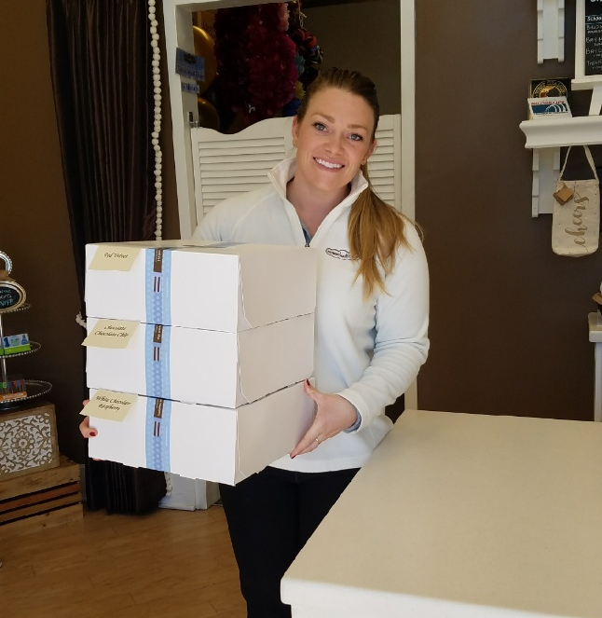
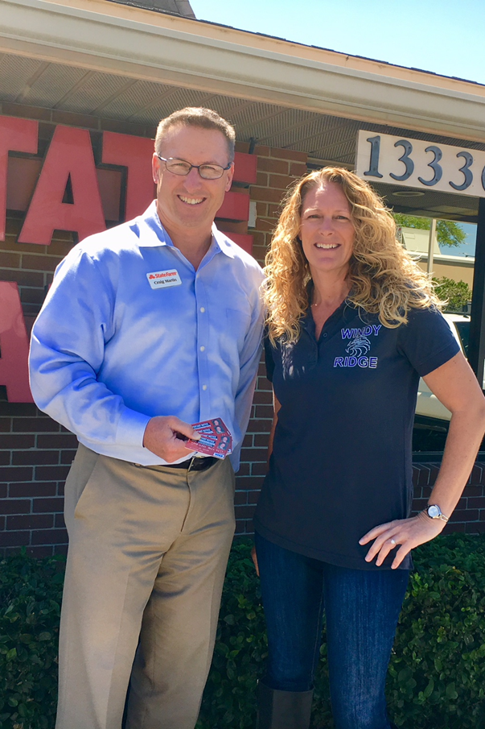
Business Partners Donate Their Resources Continued
Craig Martin, State Farm, has contributed to the purchase of t-shirts, which were given to all students, staff, faculty, administration, and volunteers of Windy Ridge School. He has also sponsored personalized water bottles, which were given to students as prizes in a school-wide fundraising effort.
Nothing Bundt Cakes donates to both the Father-Daughter Dance and Teacher Appreciation Luncheon.
Notes:
Business partnership supports teaching and learning through the donation of human resources and goods/services or financial resources.
Add as many slides necessary.

Slide 16
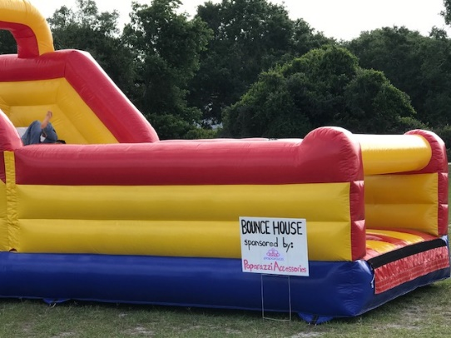
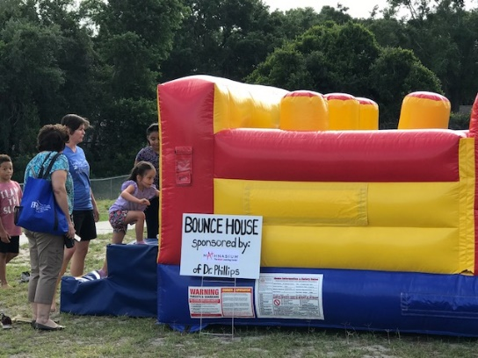
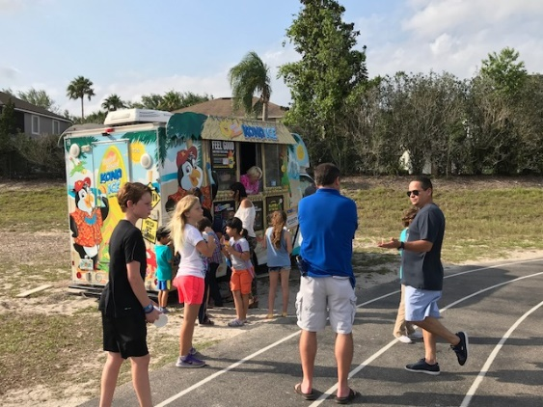
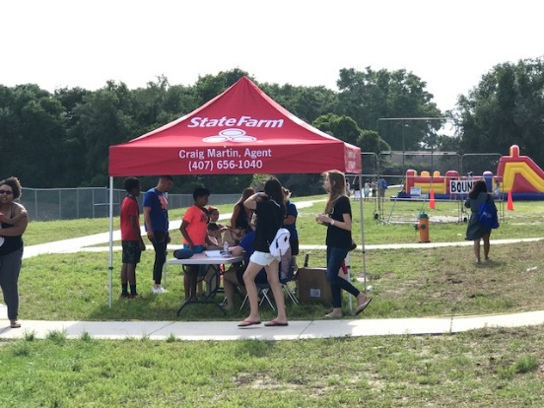
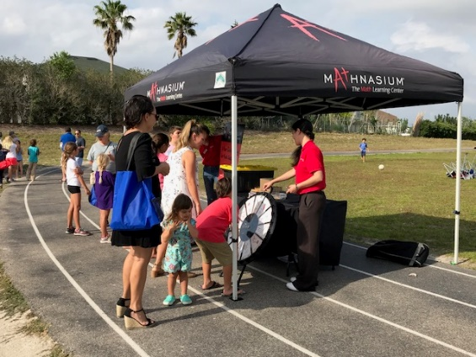
Business Partners Donate Their Resources Continued
Notes:
Business partnership supports teaching and learning through the donation of human resources and goods/services or financial resources.
Add as many slides necessary.

Slide 17
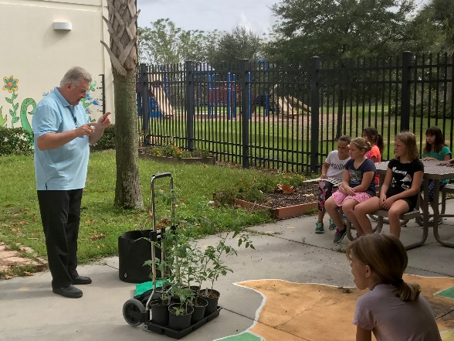
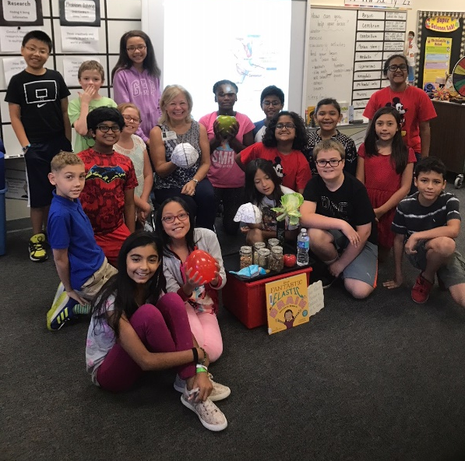
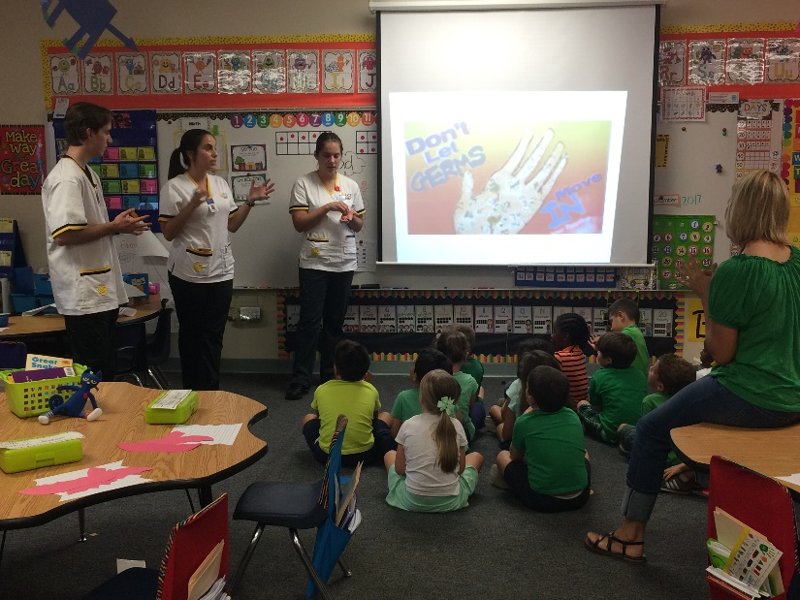
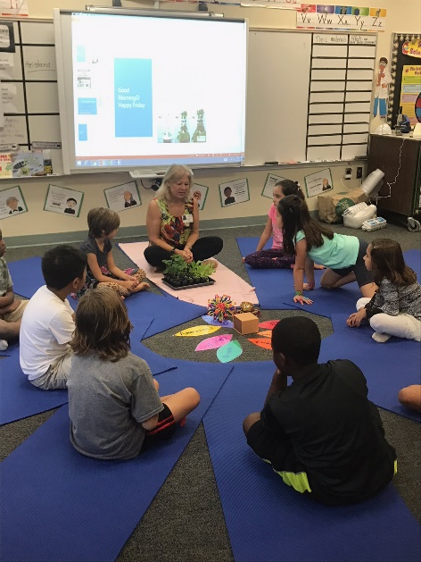
Business Partners Donate Their Resources Continued
Master Gardener from University of Florida
UCF Nursing students teaching Kindergarten about germs and hand washing.
Cheryl Albert, nurse practitioner, talks about edible plants, fruits and vegetable planted in the school garden. She also talked to students about the brain and how to care for it.
Notes:
Business partnership supports teaching and learning through the donation of human resources and goods/services or financial resources.
Add as many slides necessary.

Slide 18
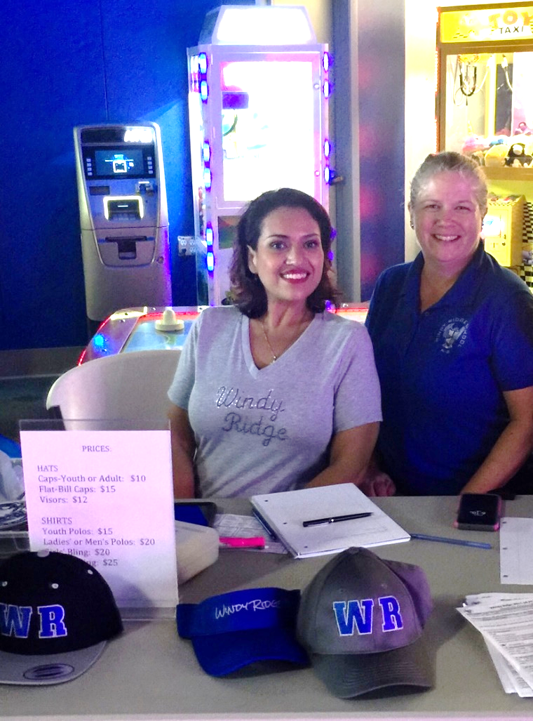
Partnership Coordinator
To become a Partner in Education, please contact our coordinators
Linda Smith &
Alicia Rosenaur.
You can email them at windyridge.pie@gmail.com
Notes:
PIE Coordinator Contact Info.
Include a picture of PIE Coordinator (If you are a coordinator for multiple programs, place your contact information on or after the Community Involvement opportunities slide; you do not have to place in multiple sections)

Slide 19
Partners in Education Orientation & Training
Notes:
Business partners received orientation and training.
One-on-one or group (E.g. picture of orientation, copy of the agenda, invitation, or sign-in roster …)

Slide 20
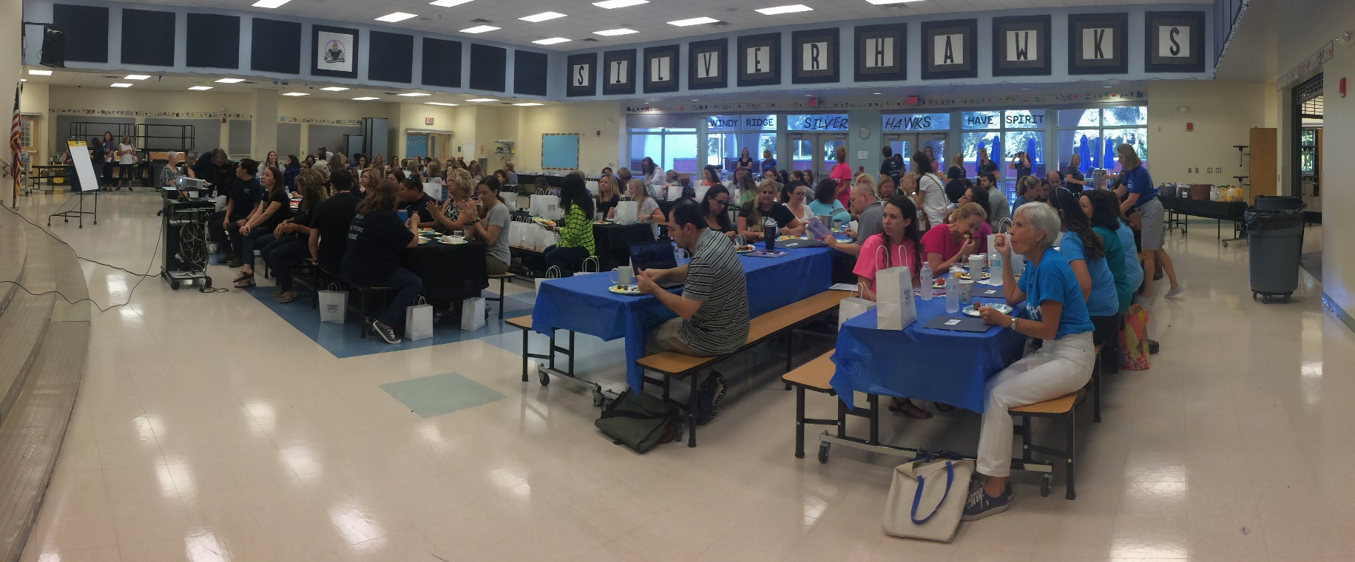
Coordinator & School Staff Trained On Effective Use of Services by Business Partners
Partners in Education
Notes:
Showcase PIE Coordinator training staff via picture.
PIE Coordinator certificate, agenda, sign-in roster in supportive folder.

Slide 21
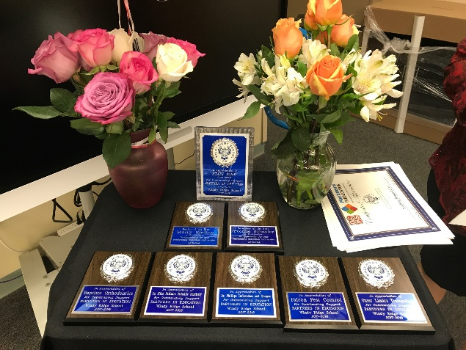
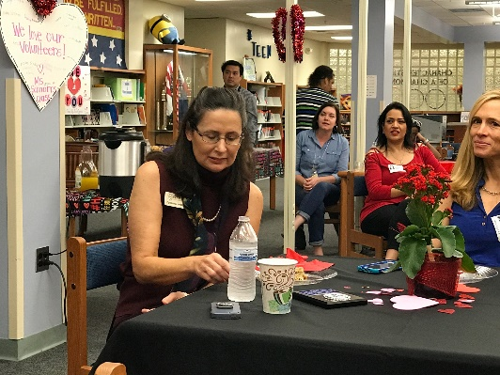
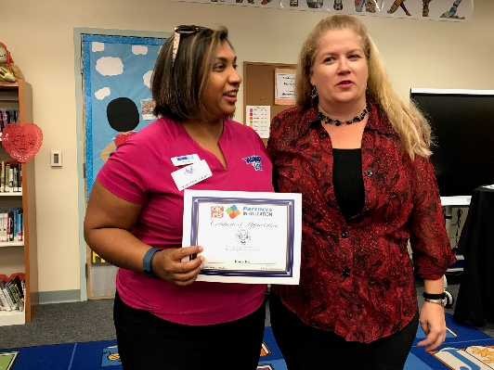
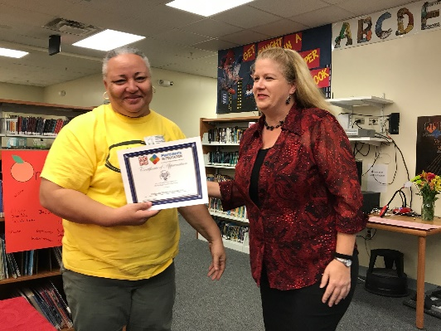
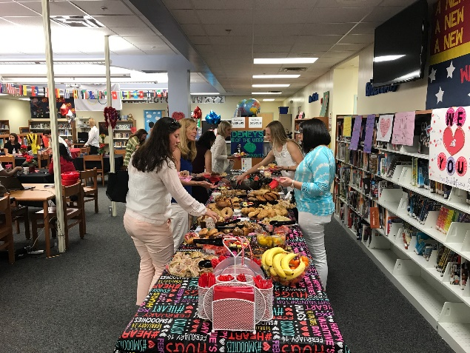
Business Partner Recognition
On February 23, 2018, Windy Ridge hosted a Breakfast to say thank you to the many businesses that provided support to our school this year.
Notes:
Newsletter, marquee, website, recognition event, student artwork, student performance…

Slide 22
Business Partner Recognition
Craig Martin, State Farm, was recognized as the Partner of the Year for Windy Ridge.
Mr. Martin has been a regular presenter at our annual Teach-In day, in which he speaks to various classes about his occupation and shares his business experiences. He has participated in our annual open house and summer camp expo events, where he has been available to discuss insurance and financial planning for college to parents of Windy Ridge and the surrounding community. In addition to being an active volunteer, Mr. Martin has also provided much-needed financial support to the Windy Ridge PTA and to the Windy Ridge fundraising efforts.
Notes:
Newsletter, marquee, website, recognition event, student artwork, student performance…

Slide 23
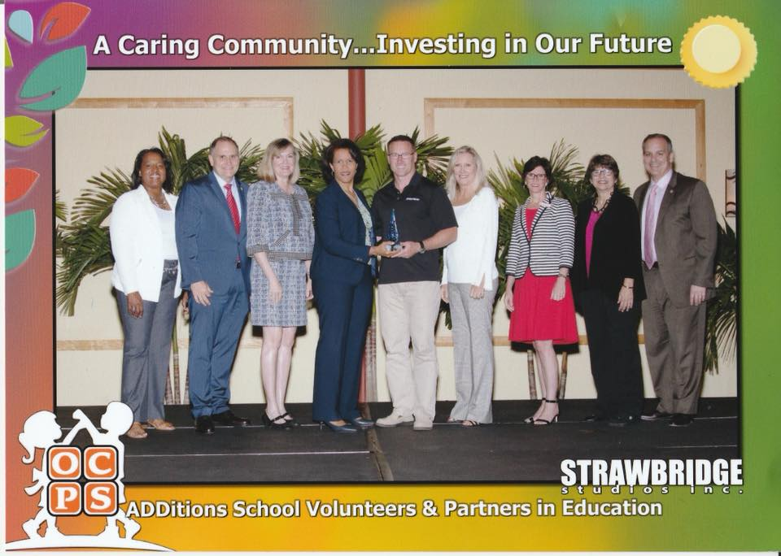
Business Partner Recognition
Craig Martin, State Farm, was honored as an Orange County Outstanding Partner.
Notes:
Newsletter, marquee, website, recognition event, student artwork, student performance…

Slide 24
Family Involvement
What Does PTA Do and Why?
Windy Ridge PTA evaluates the needs of our school and then raises funds and recruits volunteers to fulfill these needs. Our mission is make every child’s potential a reality. To accomplish our mission this year, Windy Ridge PTA is focused on 5 program areas: Family & Community Engagement, Promoting a Positive School Environment, the Arts, Health & Safety and Literacy & S.T.E.M. (Science, Technology, Engineering, Math).
Website: www.windyridgepta.com
Email: Go to website and sign up! We use Constant Contact for our email. You subscribe to it, and you unsubscribe. Email windyridgepta@gmail.com with questions.
Facebook: www.facebook.com/WindyRidgePTA. Please “like” us and we will keep you updated on school events and meeting dates.
Notes:
Insert your school’s active parent organization logo or information

Slide 25
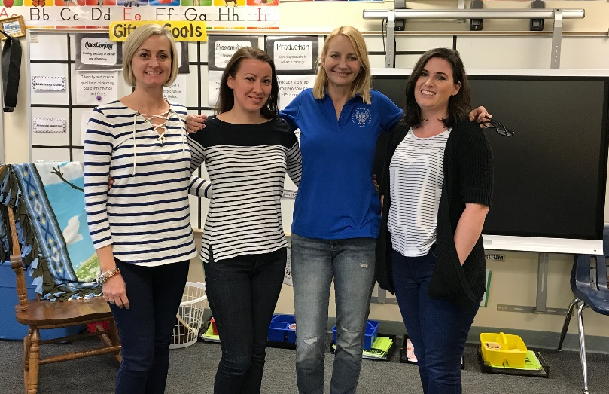
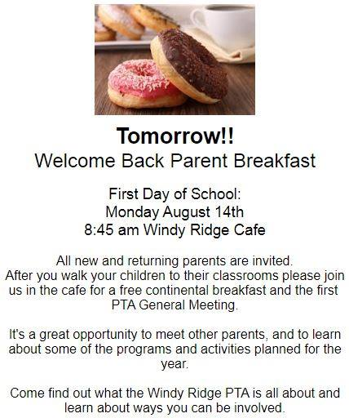
Our Parent Organization
Family Involvement
President–Terri Hrynyk
1st VP Communications–Cari Diez
2nd VP Programs–Brooke Benson
3rd VP Fundraising–Shannon Abayasekera
Treasurer–Gary Clute
Recording Secretary–Michelle Skandamis
Corresponding Secretary–Yuliya Meusel
Notes:
Must be an active partner organization (PTA, PTO, booster club…).
Introduction of your board, membership recruitment flyer, a schedule of the organization’s activities for the year…

Slide 26
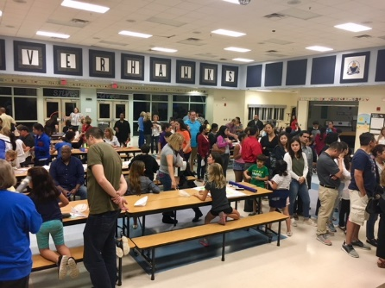
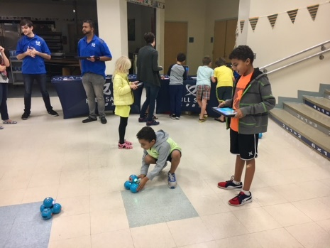
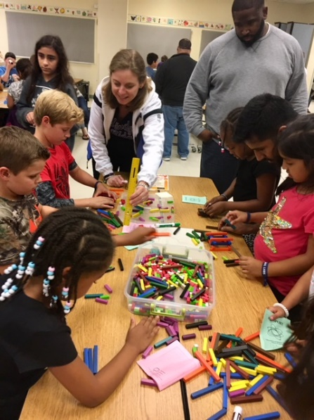
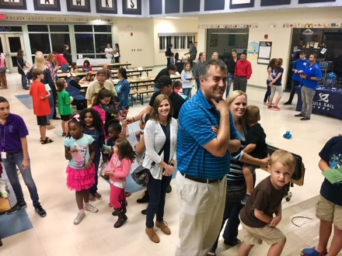
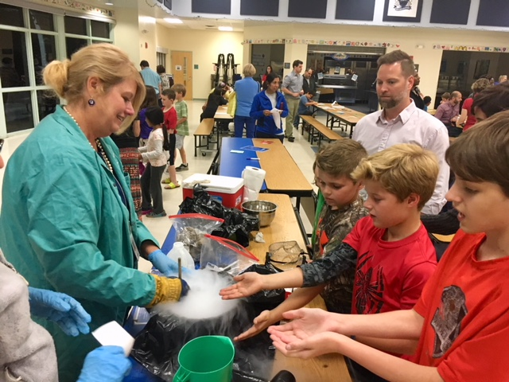
Education Opportunities are Offered to Families
Family Involvement
Notes:
Sunshine State Standards, literacy, career planning, parenting, homework assistance.
(This must focus on helping parents to improve parent involvement, and must be a school activity): preparing your child for FCAT, literacy classes, career planning, computer night, college planning, family banking, homework assistance, parenting skills, etc.

Slide 27
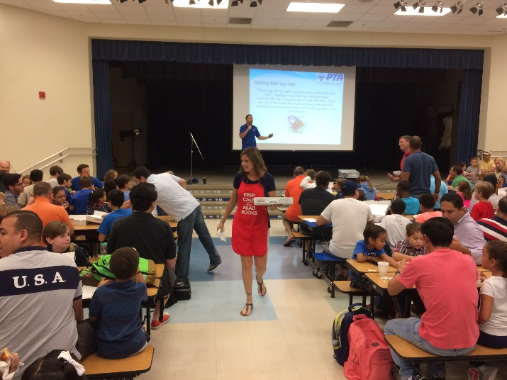
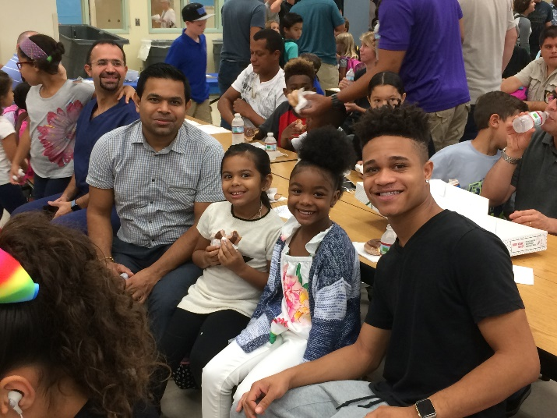
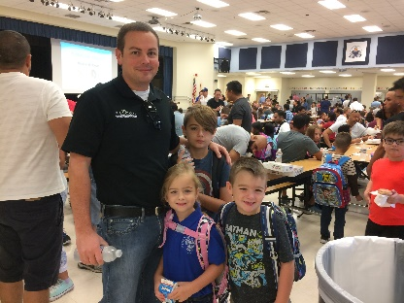
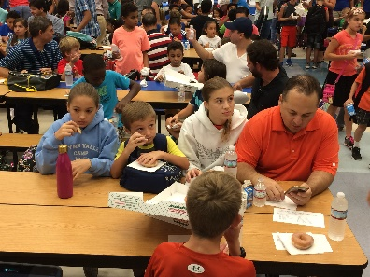
Education Opportunities are Offered to Families
Family Involvement
Dads got to hear about the importance of reading with their children during the annual Dad’s & Donuts event.
Notes:
Sunshine State Standards, literacy, career planning, parenting, homework assistance.
(This must focus on helping parents to improve parent involvement, and must be a school activity): preparing your child for FCAT, literacy classes, career planning, computer night, college planning, family banking, homework assistance, parenting skills, etc.

Slide 28
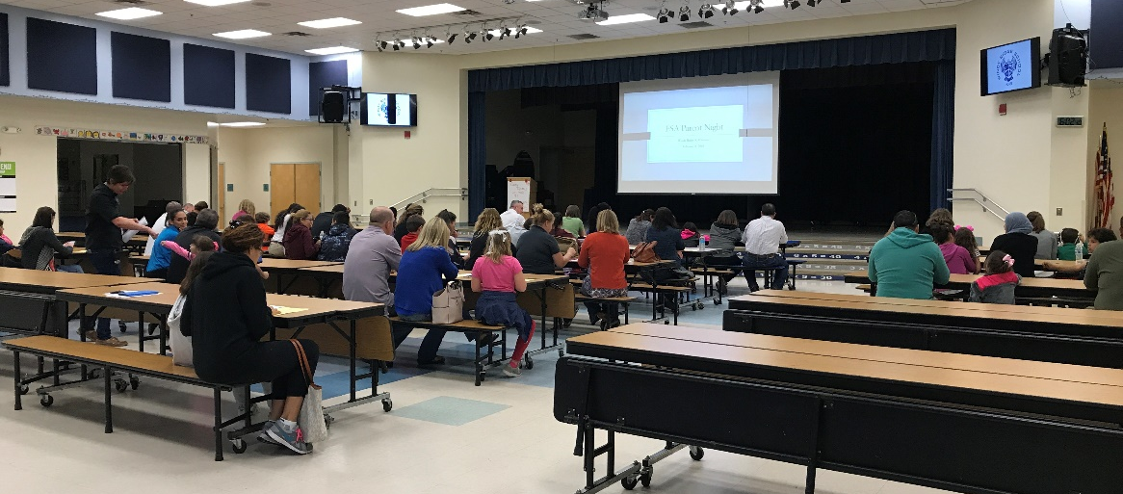
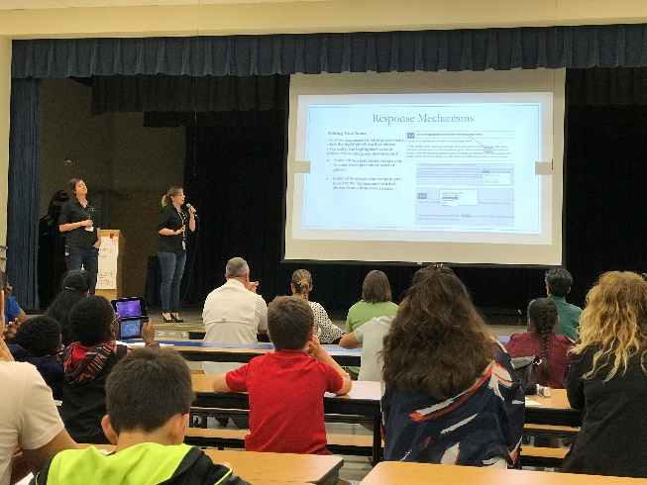
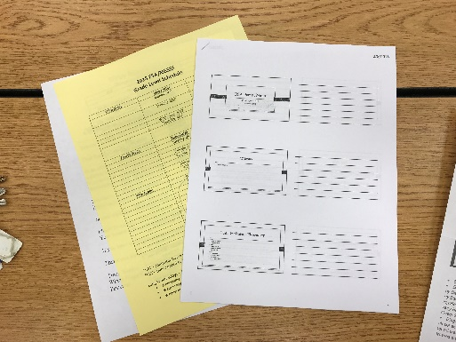
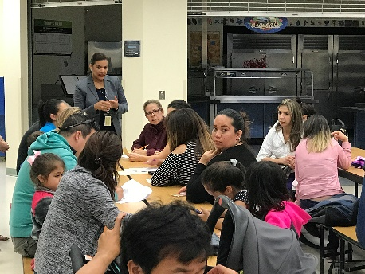
Education Opportunities are Offered to Families
Family Involvement
FSA Parent Prep
Principal Herrera translates in Spanish for ELL families.
Families learning how to help their kids be successful and prepared for the FSA.
Notes:
Sunshine State Standards, literacy, career planning, parenting, homework assistance.
(This must focus on helping parents to improve parent involvement, and must be a school activity): preparing your child for FCAT, literacy classes, career planning, computer night, college planning, family banking, homework assistance, parenting skills, etc.

Slide 29
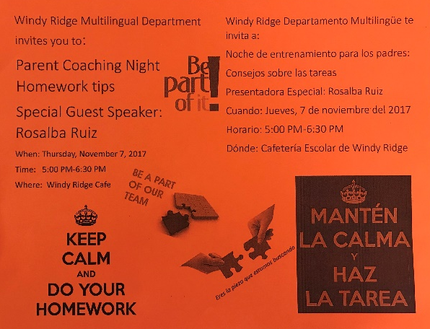
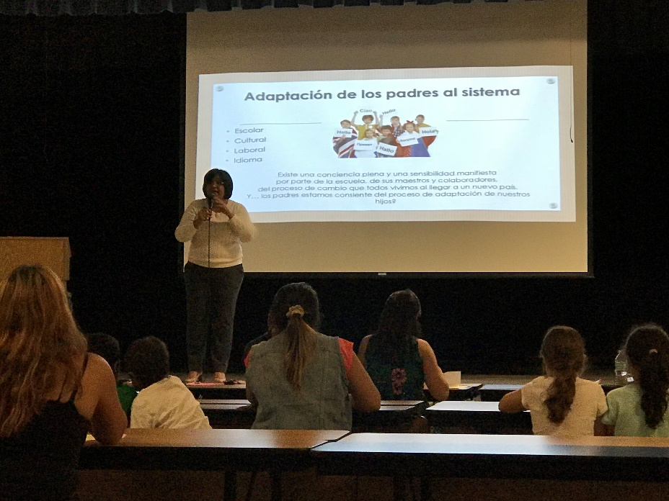
Families Participate in Focus & Discussion Groups
Family Involvement
Parent Coaching Nights
Notes:
E.g., parenting, drug awareness, safety, and violence prevention, etc.
These must focus on the school’s activities to help parents cope with family problems that may impact the education of the student, such as drug and alcohol, domestic violence, raising grandchildren, setting limits, ESE support, divorce, etc.

Slide 30
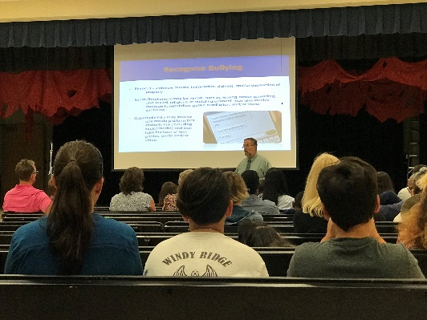
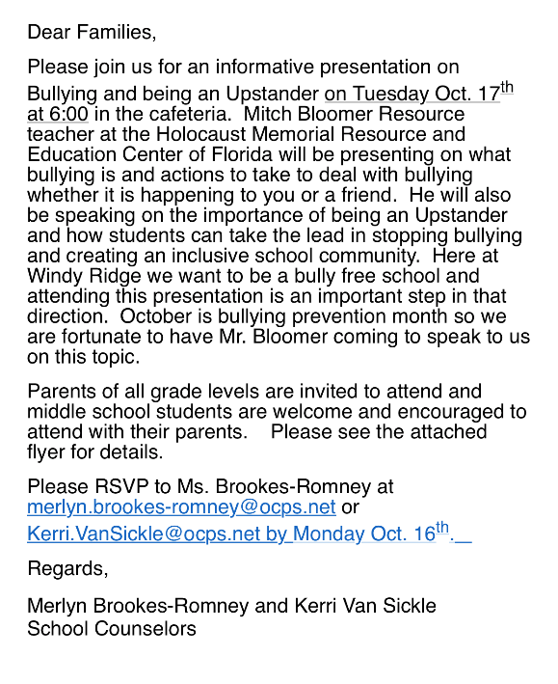
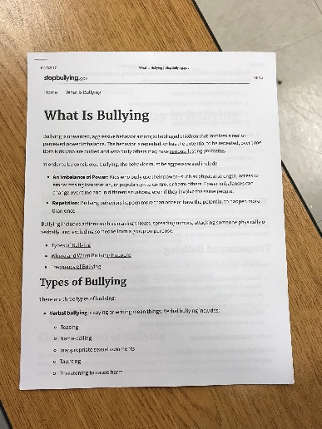
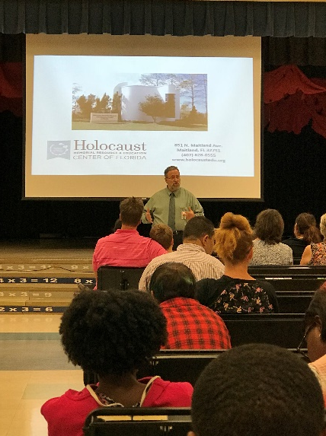
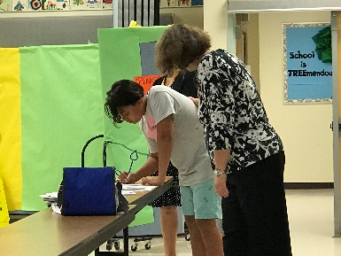
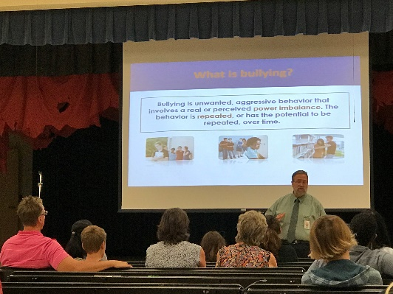
Joint Parent and Student Training
Family Involvement
Family Session on Bullying
Notes:
Joint parent and student training (e.g., academic skills, family reading, violence prevention, financial aid) is available.
(At least one session of the training must include students and parents learning together in the same activity.
Agenda, program, handouts or sign-in sheets clearly showing both parents and students
Note: Try not to use the same activities

Slide 31
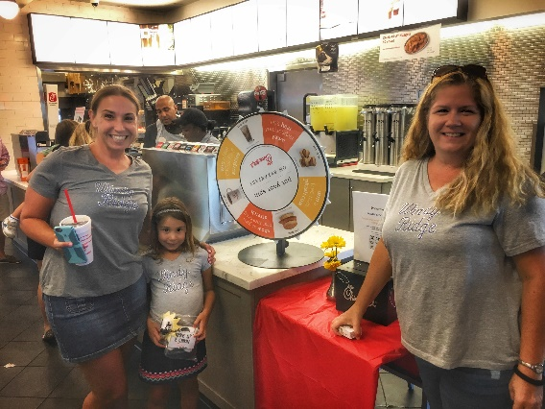
Family Outreach Programs
Family Involvement
Let’s Skate
Chick-Fil-A
Notes:
Family outreach activities are offered through collaborative or facilitated activities (e.g., neighborhood meetings, tutorial services, off-site programs).
(This criterion focuses on the considerations your school gives to families who do not desire to attend activities at the school due to personal schedules, transportation issues, or personal attitudes. Activities should be primarily held away from the school.)
Family Reading Night at bookstore location (show collaboration)
Home visits by faculty, weekend family activities (bicycle safety program on Saturday), family event at a neighborhood site (a picnic or dinner)
SAC/PTA/PTO/PTSA meeting at a local neighborhood location

Slide 32
More than 60% of Our Families Participate in Families Involvement Activities
Family Involvement
Students and Teachers offered a “How to Survive Middle School for new 6th grader families.
Meet the Teacher
Notes:
A minimum of 60% of families are involved in a positive way in the school more than once during the year.
Showcase pictures of different families participating in activities – include a brief description.
The Chart is one example of how the data can be collected based on activities (Each color section represents an activity).

Slide 33
More than 60% of Our Families Participate in Families Involvement Activities
Family Involvement
Families attend Orchestra and Band Performances
Dads N’ Donuts – over 300 people
Open House to learn about curriculum being taught
Book Fairs Held Twice Each Year – saw more than 250 families
Notes:
A minimum of 60% of families are involved in a positive way in the school more than once during the year.
Showcase pictures of different families participating in activities – include a brief description.
The Chart is one example of how the data can be collected based on activities (Each color section represents an activity).

Slide 34
More than 60% of Our Families Participate in Families Involvement Activities
Family Involvement
Drama holds three performances with more than 100 people at each
Moms and Muffins with 300 attending
Notes:
A minimum of 60% of families are involved in a positive way in the school more than once during the year.
Showcase pictures of different families participating in activities – include a brief description.
The Chart is one example of how the data can be collected based on activities (Each color section represents an activity).

Slide 35
More than 60% of Our Families Participate in Families Involvement Activities
Family Involvement
Reading night! Families were invited to visit the book fair and hear teachers read books. There was also a bilingual reading for ELL families.
Notes:
A minimum of 60% of families are involved in a positive way in the school more than once during the year.
Showcase pictures of different families participating in activities – include a brief description.
The Chart is one example of how the data can be collected based on activities (Each color section represents an activity).

Slide 36
Teachers and School Staff Communication Techniques With Families
Family Involvement
Stay informed!
Check out our website daily
Opt in for the Principal’s Connect Orange messages
Subscribe to our newsletter
Windy Ridge Website
Teacher Weekly Emails
Notes:
Evidence of a variety of communication techniques with families by teachers and school staff. (Documentation should show regular, two-way communication, using a variety of mediums.)
Listing of communication methods used by the school, with examples of several (i.e. connect-Orange…)
Newsletters, weekly bulletins and flyers
Log of telephone calls to parents or script of automated calls (include date)
Written correspondence to parents and families
Parent conference logs
Bilingual editions of printed bulletins, etc.
A copy of the school web page dealing with parent information

Slide 37
Teachers and School Staff Communication Techniques With Families
Family Involvement
Parents can receive pictures, behavior updates and message with teachers via ClassDojo.
Weekly Newsletters
Information goes home in Spanish
Notes:
Evidence of a variety of communication techniques with families by teachers and school staff. (Documentation should show regular, two-way communication, using a variety of mediums.)
Listing of communication methods used by the school, with examples of several (i.e. connect-Orange…)
Newsletters, weekly bulletins and flyers
Log of telephone calls to parents or script of automated calls (include date)
Written correspondence to parents and families
Parent conference logs
Bilingual editions of printed bulletins, etc.
A copy of the school web page dealing with parent information

Slide 38
Welcome
Family Involvement
Upon walking in the door, parents are greeted by the front office staff. There are bulletin boards telling them about PTA, photos of the teachers, student leaders, heritage pride flags and an easel that displays an upcoming event.
Notes:
Ensure that welcome signage is near the entrance and any other interaction with parents creates a climate in which parents feel valued and welcome.

Slide 39
School Provides Parents Policies and Best Practice Information
Family Involvement
Visit the Windy Ridge website for more information.
windyridgek8.ocps.net
Notes:
Provide parents with current information regarding school policies, practices and both school and student performance.
Samples of information sent home during the year, such as: Student Code of Conduct, letter from principal/ superintendent, volunteer orientation agenda, website…

Slide 40
ADDitions school volunteers are extra-special people who are committed to making schools the best they can be. They offer special attention and caring that can inspire students to reach for, and realize their dreams.
School volunteers work at the schools of their choice and participate in activities that match their interests. Be a school volunteer and help make students' dreams come true.
Notes:
OCPS’ official school volunteer program is called the ADDitions School Volunteer.
Market – (Use several slides)
Outstanding Volunteers
Showcase volunteer activities

Slide 41
Golden School Award
Additions
school volunteers
Notes:
Scan in your school’s Golden School Award certificate

Slide 42
Register to be aN
Volunteering is Easy!
Register online: volunteer.ocps.net
Click on “Volunteer Now”
Search for an Opportunity
Look for our school name and sign-up for “Become an ADDitions School Volunteer” opportunity.
Notes:
Recommended
Each note section will include the criteria from the Five Star Application.
In lieu of using criteria as a heading – use the summarizes the criteria heading included in the slide
Criteria - Each community/business/agency signs an annual, jointly developed plan of partnership activities.
Showcase an example of one of your school’s Partner in Education profile’s from the new Partners in Education Management system. Must refelect this school year’s partnership.

Slide 43
ADDitions Coordinator Laura Matthews laura.matthews@ocps.net
Additions
school volunteers
Notes:
ADDitions Coordinator’s contact information and picture.
School volunteer coordinator has been designated to provide leadership for the school volunteer program through recruitment, placement, training, and supervision of participants.

Slide 44
School Staff Trained on Effective Use of School Volunteers
Additions
school volunteers
Notes:
Showcase staff being trained by the ADDitions Coordinator.
A minimum of 80% of the school staff have participated in school-based volunteer training during the school year.
Picture of staff being trained.
Sign-in sheet must be place in supporting documents folder. DO NOT INCLUDE SIGN IN SHEET IN PORTFOLIO

Slide 45
Total Number of Volunteer Hours
Additions
school volunteers
Volunteer Hours
= 7,856+
Activities include book fairs, dad and donuts, moms and munchkins, mother/son picnic, father/daughter dance, beautification day, prop painting for drama, field day, hearing screening, vision screening, classroom volunteers, AR rewards… and more!
Notes:
Total number of hours in volunteer service equals twice the number of students enrolled in the school. (Any volunteer activity that contributes to student improvement may be counted.)
Example: Student enrollment: 500; Volunteer hours: 1,000 or more
Include the a list of the different activities and/or include a volunteer activity on this slide.

Slide 46
Outstanding Volunteers
Additions
school volunteers
Notes:
Market – (Use several slides)
Outstanding Volunteers
Showcase volunteer activities

Slide 47
Additions
school volunteers
Molly Smiley
Mentor of the Year!
Mrs. Smiley is an incredibly kind and caring mentor. She shows her mentees unconditional positive regard and they know she is a constant support in their life. She is encouraging and gives freely of her time and attention. She is insightful and plants seeds of hope with each of her mentees and empowers and encourages them to not only see, but strive to reach their fullest potential.
Notes:
Market – (Use several slides)
Outstanding Volunteers
Showcase volunteer activities

Slide 48
Volunteer of the Year
Additions
school volunteers
Yvonne Schaffer
Volunteer of the Year!
Mrs. Schaefer volunteers regularly in our self-contained classrooms for students with significant disabilities. Almost single-handedly, Mrs. Schaeffer has improved the outdoor play area. She and volunteers she organized repaired toys, cleaned and painted, as well as built a child-sized village, which includes a police station and drive-thru eatery. When the weekend forecast calls for rain, she has been known to come to school to cover up playground equipment and do grounds upkeep. When back packs need washing, she will take them home for a much-needed cleaning and return them to our appreciative students and their parents.
Notes:
Market – (Use several slides)
Outstanding Volunteers
Showcase volunteer activities

Slide 49
Additions
school volunteers
Karen DePriest
300+ hours
Karen serves on the SAC Committee, and on the PTA as the Homeroom Representatives Coordinator. She works with the 4th and 5th grade gifted classes each week. One day a week she does AR in Kindergarten and 2nd grade. She also helps with events like Fun Run, Field Day, classroom parties and field trips.
Shannon Abayasekera
50+ hours
Shannon serves on the PTA. This year she led our PTA Fall Fundraising Event. She also volunteers as a Homeroom Rep and a variety of other school events.
Notes:
Market – (Use several slides)
Outstanding Volunteers
Showcase volunteer activities

Slide 50
Additions
school volunteers
Theresa McNeil
50+ hours
Theresa serves as a Windy Ridge mentor. She is active in PTA and helps organize the twice yearly Scholastic Bookfair, spending hours helping kids find books.
Billie LaVerdi
50+ hours
Billie is on PTA and helps organize the Scholastic Book fair held each Fall and Spring. She is a Homeroom Rep for her son’ class and volunteers for other events like Dad’s & Donuts.
Notes:
Market – (Use several slides)
Outstanding Volunteers
Showcase volunteer activities

Slide 51
Additions
school volunteers
Linda Smith
300+ hours
Linda serves at the PTA ADDitions Coordinator and she helps ourganize the school Partners in Education. She is a Homeroom Representative for her son’s class and can be seen around the school helping out with things like picture day, book fair, and the back to school breakfast.
Terri Guiang
20+ hours
Terri is an Art Teacher at Windy Ridge. She went above and beyond this year by, in her own time, helping to run the PTA Reflections Art Contest.
Notes:
Market – (Use several slides)
Outstanding Volunteers
Showcase volunteer activities

Slide 52
Additions
school volunteers
Cari Diez - 50+ hours
Brooke Benson - 50+ hours
Clement Ellis - 600+ hours
Michelle Cox - 50+ hours
Notes:
Market – (Use several slides)
Outstanding Volunteers
Showcase volunteer activities

Slide 53
School Volunteer Recognition
Additions
school volunteers
Notes:
Showcase samples of the different forms of school volunteer recognition. E.g. newsletter, marquee, website, recognition event, student artwork, student performance…

Slide 54
Student Community Service
Notes:
Introduce the Student Community service section – Ex. Students at XYZ School are learning how to give back to based on needs and for the betterment of our community .

Slide 55
Student Service Learning Project
STUDENT
COMMUNITY SERVICE
Hello Parents and Guardians!
This is Ms. Brookes-Romney, school counselor here at Windy Ridge for grades 5-8. I hope you all have fared well after the storm. We are talking with our Windy Ridge families and students to provide any additional support needed.
Our teachers and student organizations are spear-heading a drive to support our local schools that have been identified as being hard-hit with major damage and flooding. These areas affect students at Orlo Vista ES, Ivey Lane ES and Jones HS (Orlo Vista neighborhood), and at Rock Springs ES in the Apopka area.
At this time, they are in need of the following items:
Food- non-perishable, preferably bagged or boxed since cans are heavy, hard to transport, and the contents usually require cooking
Water-for drinking, cooking and cleaning
Hygiene items- toothbrushes, toothpaste, soap, shampoo, deodorant, etc.
Clothing (preferably new)- light jackets for K-2nd grade and 5th grade
Socks and underwear (new only)
Towels, sheets and blankets
This is a school-wide initiative and we are asking parents to bring in any of the above items tomorrow - especially during open house. We will continue to accept items through the middle school open house on Tuesday (9/26) (we will assess their needs at that point). Labeled bins and boxes will be placed in the cafeteria for collection.
We are grateful for any donation you can provide and are thankful for your generosity.
Have a wonderful evening.
Donations were given to Orio Vista and Ivy Lane Elementary schools.
Notes:
School provides opportunities to students for service learning that focus on identified community needs (e.g., renovating a park, working at election polls, feeding homeless).
Write a description of how students identified a need and showcase the resolution.

Slide 56
STUDENT
COMMUNITY SERVICE
Windy Ridge collected donations for the
Leukemia and Lymphoma Society
Monday Feb. 26th-Thursday March 15th.
Our goal was to raise $2,000 or more. We ended up raising $8,120.24
Students were encouraged to bring in coins or dollar bills throughout the three weeks and deposit them in the classroom collection box. Elementary students also received a collection box that they took home for donations from parents co-workers, neighbors, family, and friends. We also had a link on the Windy Ridge website for on-line donations.
March 9, 2018 was hat day.
For a $1 donation, students could wear hats.
Notes:
A minimum of 50% of students are involved in community activities (e.g., pen pals to shut-ins, food drives, cross school tutoring activities).
Slide 1

Slide 57
Food drive
STUDENT
COMMUNITY SERVICE
COMMUNITY SERVICE PROJECT:
We will be having a food drive from October 23-November 10th sponsored by the Student Ambassadors. All donations will be sent to Bread of Life in Ocoee.
The following grade levels are asked to have students donate the following items from October 23rd-November 10th:
There will be boxes placed in the front office for these supplies. Thank you in advance for your support.
Please feel free to peruse the websites listed below for facts and classroom activities.
www.nfp.org
www.imdrugfree.com
www.redribbon.org
Thank you for your support and enthusiasm of Red Ribbon Week 2017! Ms. Brookes-Romney and Ms. Van Sickle, School Counselors
Students collected over 400 pounds worth of food.
Notes:
A minimum of 50% of students are involved in community activities (e.g., pen pals to shut-ins, food drives, cross school tutoring activities).
Slide 2

Slide 58
School Advisory Council
Notes:
Market your SAC (insert slides to include recommendation below)
Introduce the SAC Board Members
Showcase SAC activities
If your school was a Five Star School last year, consider showcasing the COMMUNITY INVOLVEMENT new idea that was placed in current school improvement plan.

Slide 59
Meet Our Members
SCHOOL
ADVISORY
COUNCIL
Members
Tracy Webley
Joanna Bradford
Kimberly Buchan
Darrin Chambers
Marc Cohen
Karen DePriest
Rosmary Jerez Franco
Claudia Genovese-Martinez
Althea Jackson
Stacey Jackson-Rauso
Kurt Meusel
Catherine Thompson
J. David Vandersteen
Anna Fidelo
Mana Heistand
Jody Crombie
Terri Guiang
Vaness Smith
Notes:
Include a list of the official SAC Roster in portfolio (member names, type of member and attendance calculations for each meeting).
Insert SAC Data Form in Supporting Document Folder
A minimum of 8 meetings are held per year. Average 80% attendance of members.
Tip – In preparation of not meeting the 8 meeting requirement, schedule now at least two alternative meetings for the end of the year. If you end up not needing them, you will be set for the requirement.

Slide 60
School Improvement Plan Annual Presentation
SCHOOL
ADVISORY
COUNCIL
Notes:
Annual presentation of School Improvement Plan to school community after public notice to all stakeholders (school marquee, flyers, etc.) is made.
Include a picture of the public notice

Slide 61
School Advisory Council Development Training
SCHOOL
ADVISORY
COUNCIL
SAC trained on revisions to the school improvement plan and the school budget for the following school year.
Notes:
Evidence of ongoing training and/or development of the school advisory council.
What training was offered to the SAC this year? Include a picture and statement
This training should be documented via the SAC Minutes; therefore place in Supporting Documents folder.

Slide 62
The 2018-2019 Community Involvement One New Idea for Implementation
SCHOOL
ADVISORY
COUNCIL
After reviewing the SAC survey parents and students filled out, it was decided next year to focus on Bullying at Windy Ridge. Helping kids understand what it looks like and how to stop it, while also educating parents.
Notes:
School Improvement Plan reflects one new idea that involves the community in its implementation.
Tip – Activity reflects a year’s planning – The SAC met all year long, how has community involvement been included in the discussion of school improvement for the upcoming year. Please note, it’s the idea, not the actual activity.
As in the SAC slide 1 indicates, if you were a Five Star School last year, I recommend showcasing the previous year’s implemented idea. Include a description and a picture.

Slide 63
The Community Involvement Idea Implemented in 2017-2018
SCHOOL
ADVISORY
COUNCIL
With the student population at Windy Ridge becoming more and more diverse, the school wanted to find ways to celebrate and embrace Multi-Culturalism.
Notes:
Showcase the previous year’s implemented idea. Include a description and a picture.
Only for current Five Star Schools.

Slide 64
The Community Involvement Idea Implemented in 2017-2018
SCHOOL
ADVISORY
COUNCIL
Students visited with local members of the community who talked about their heritage and traditions in the countries they come from.
Mr. Shah speaking to the class about growing up in India, his family an countries traditions and the Celebration of Diwali, The Festival of Lights.
Notes:
Showcase the previous year’s implemented idea. Include a description and a picture.
Only for current Five Star Schools.

Slide 65
Needs Assessment Data
SCHOOL
ADVISORY
COUNCIL
SAC going over the results of the survey.
Notes:
School Advisory Council participated in the development and/or interpretation of the needs assessment data.
Sample of survey instrument and/or results

Slide 66
School Staff and SAC Members Trained on Collaborative Partnering and Shared Decision-making
SCHOOL
ADVISORY
COUNCIL
SAC uses its By-laws and Robert’s Rules of order to make decisions. SAC reviews the by-laws annually and votes on any recommended changes.
Notes:
Training provided for staff and SAC members on collaborative partnering and shared decision-making.
Note: How does the SAC make decisions? (i.e. By-laws, Robert’s Rules of Order…) How is it communicated to staff and the SAC?
Take a picture of the training and describe the training as well.
This training should be documented via the SAC Minutes; therefore place in Supporting Documents folder.

Slide 67
Thank You for Previewing Our Five Star School Portfolio
Contact us to participate in our
community involvement programs
3900 Beech Tree Drive, Orlando, FL 32835-2501
Phone 407-296-5100
Five Star School Portfolio Created by Karen DePriest
Graphics provided Kim Boulnois, OCPS Graphic Artist
Notes:
Five Star School Portfolio Created by [add your name] – Replace with Five Star School Coordinator’s Name
Important - If the graphics artwork is not owned by you give credit to graphic designer or company.

